Slide 1
Data Science
Session – 13
Date – 09th June, 2022

Slide 2
Statistics - Average
An average is a measure of where most of the values in the data are located.

Slide 3
The Center of the Data
The center of the data is where most of the values in the data are located. Averages are measures of the location of the center.
There are different types of averages. The most commonly used are:
Mean
Median
Mode
Note: In statistics, averages are often referred to as 'measures of central tendency'.
For example, using the values:
40, 21, 55, 21, 48, 13, 72

Slide 4
Statistics - Mean
The mean is a type of average value, which describes where center of the data is located.
The mean is usually referred to as 'the average'.
The mean is the sum of all the values in the data divided by the total number of values in the data.
The mean is calculated for numerical variables. A variable is something in the data that can vary, like:
Age
Height
Income
Note: There are are multiple types of mean values. The most common type of mean is the arithmetic mean.
Here 'mean' refers to the arithmetic mean.

Slide 5
Calculation or mean with Programming
Example
With Python use the NumPy library mean() method to find the mean of the values 4,11,7,14:
import numpy values = [4,11,7,14] x = numpy.mean(values) print(x)
Use the R mean() function to find the mean of the values 4,11,7,14:
values <- c(4,7,11,14) mean(values)

Slide 6
Statistics - Median
The median is a type of average value, which describes where the center of the data is located.
The median is the middle value in a data set ordered from low to high.
Note: It is important that the numbers are ordered before you can find the median.
Finding the Median with Programming
With Python use the NumPy library median() method to find the median of the values 13, 21, 21, 40, 42, 48, 55, 72:
import numpy values = [13,21,21,40,42,48,55,72] x = numpy.median(values) print(x)
Use the R median() function to find the median of the values 13, 21, 21, 40, 42, 48, 55, 72:
values <- c(13,21,21,40,42,48,55,72) median(values)

Slide 7
Statistics - Mode
The mode is a type of average value, which describes where most of the data is located.
The mode is the value(s) that are the most common in the data.
A dataset can have multiple values that are modes.
A distribution of values with only one mode is called unimodal.
A distribution of values with two modes is called bimodal. In general, a distribution with more than one mode is called multimodal.
Mode can be found for both categorical and numerical data.

Slide 8
Finding the Mode with Programming
With Python use the statistics library multimode() method to find the modes of the values 4,7,3,8,11,7,10,19,6,9,12,12:
from statistics import multimode values = [4,7,3,8,11,7,10,19,6,9,12,12] x = multimode(values) print(x)
Using R with a user-defined function to find the modes of the values 4,7,3,8,11,7,10,19,6,9,12,12:
mode <- function(x) { unique_values <- unique(x) table <- tabulate(match(x, unique_values)) unique_values[table == max(table)] } values <- c(4,7,3,8,11,7,10,19,6,9,12,12) mode(values)

Slide 9
Statistics - Variation
Variation is a measure of how spread out the data is around the center of the data.

Slide 10
The Variation of the Data
Measures of variation are statistics of how far away the values in the observations (data points) are from each other.
There are different measures of variation. The most commonly used are:
Range
Quartiles and Percentiles
Interquartile Range
Standard Deviation
Measures of variation combined with an average (measure of center) gives a good picture of the distribution of the data.
Note: These measures of variation can only be calculated for numerical data.

Slide 11
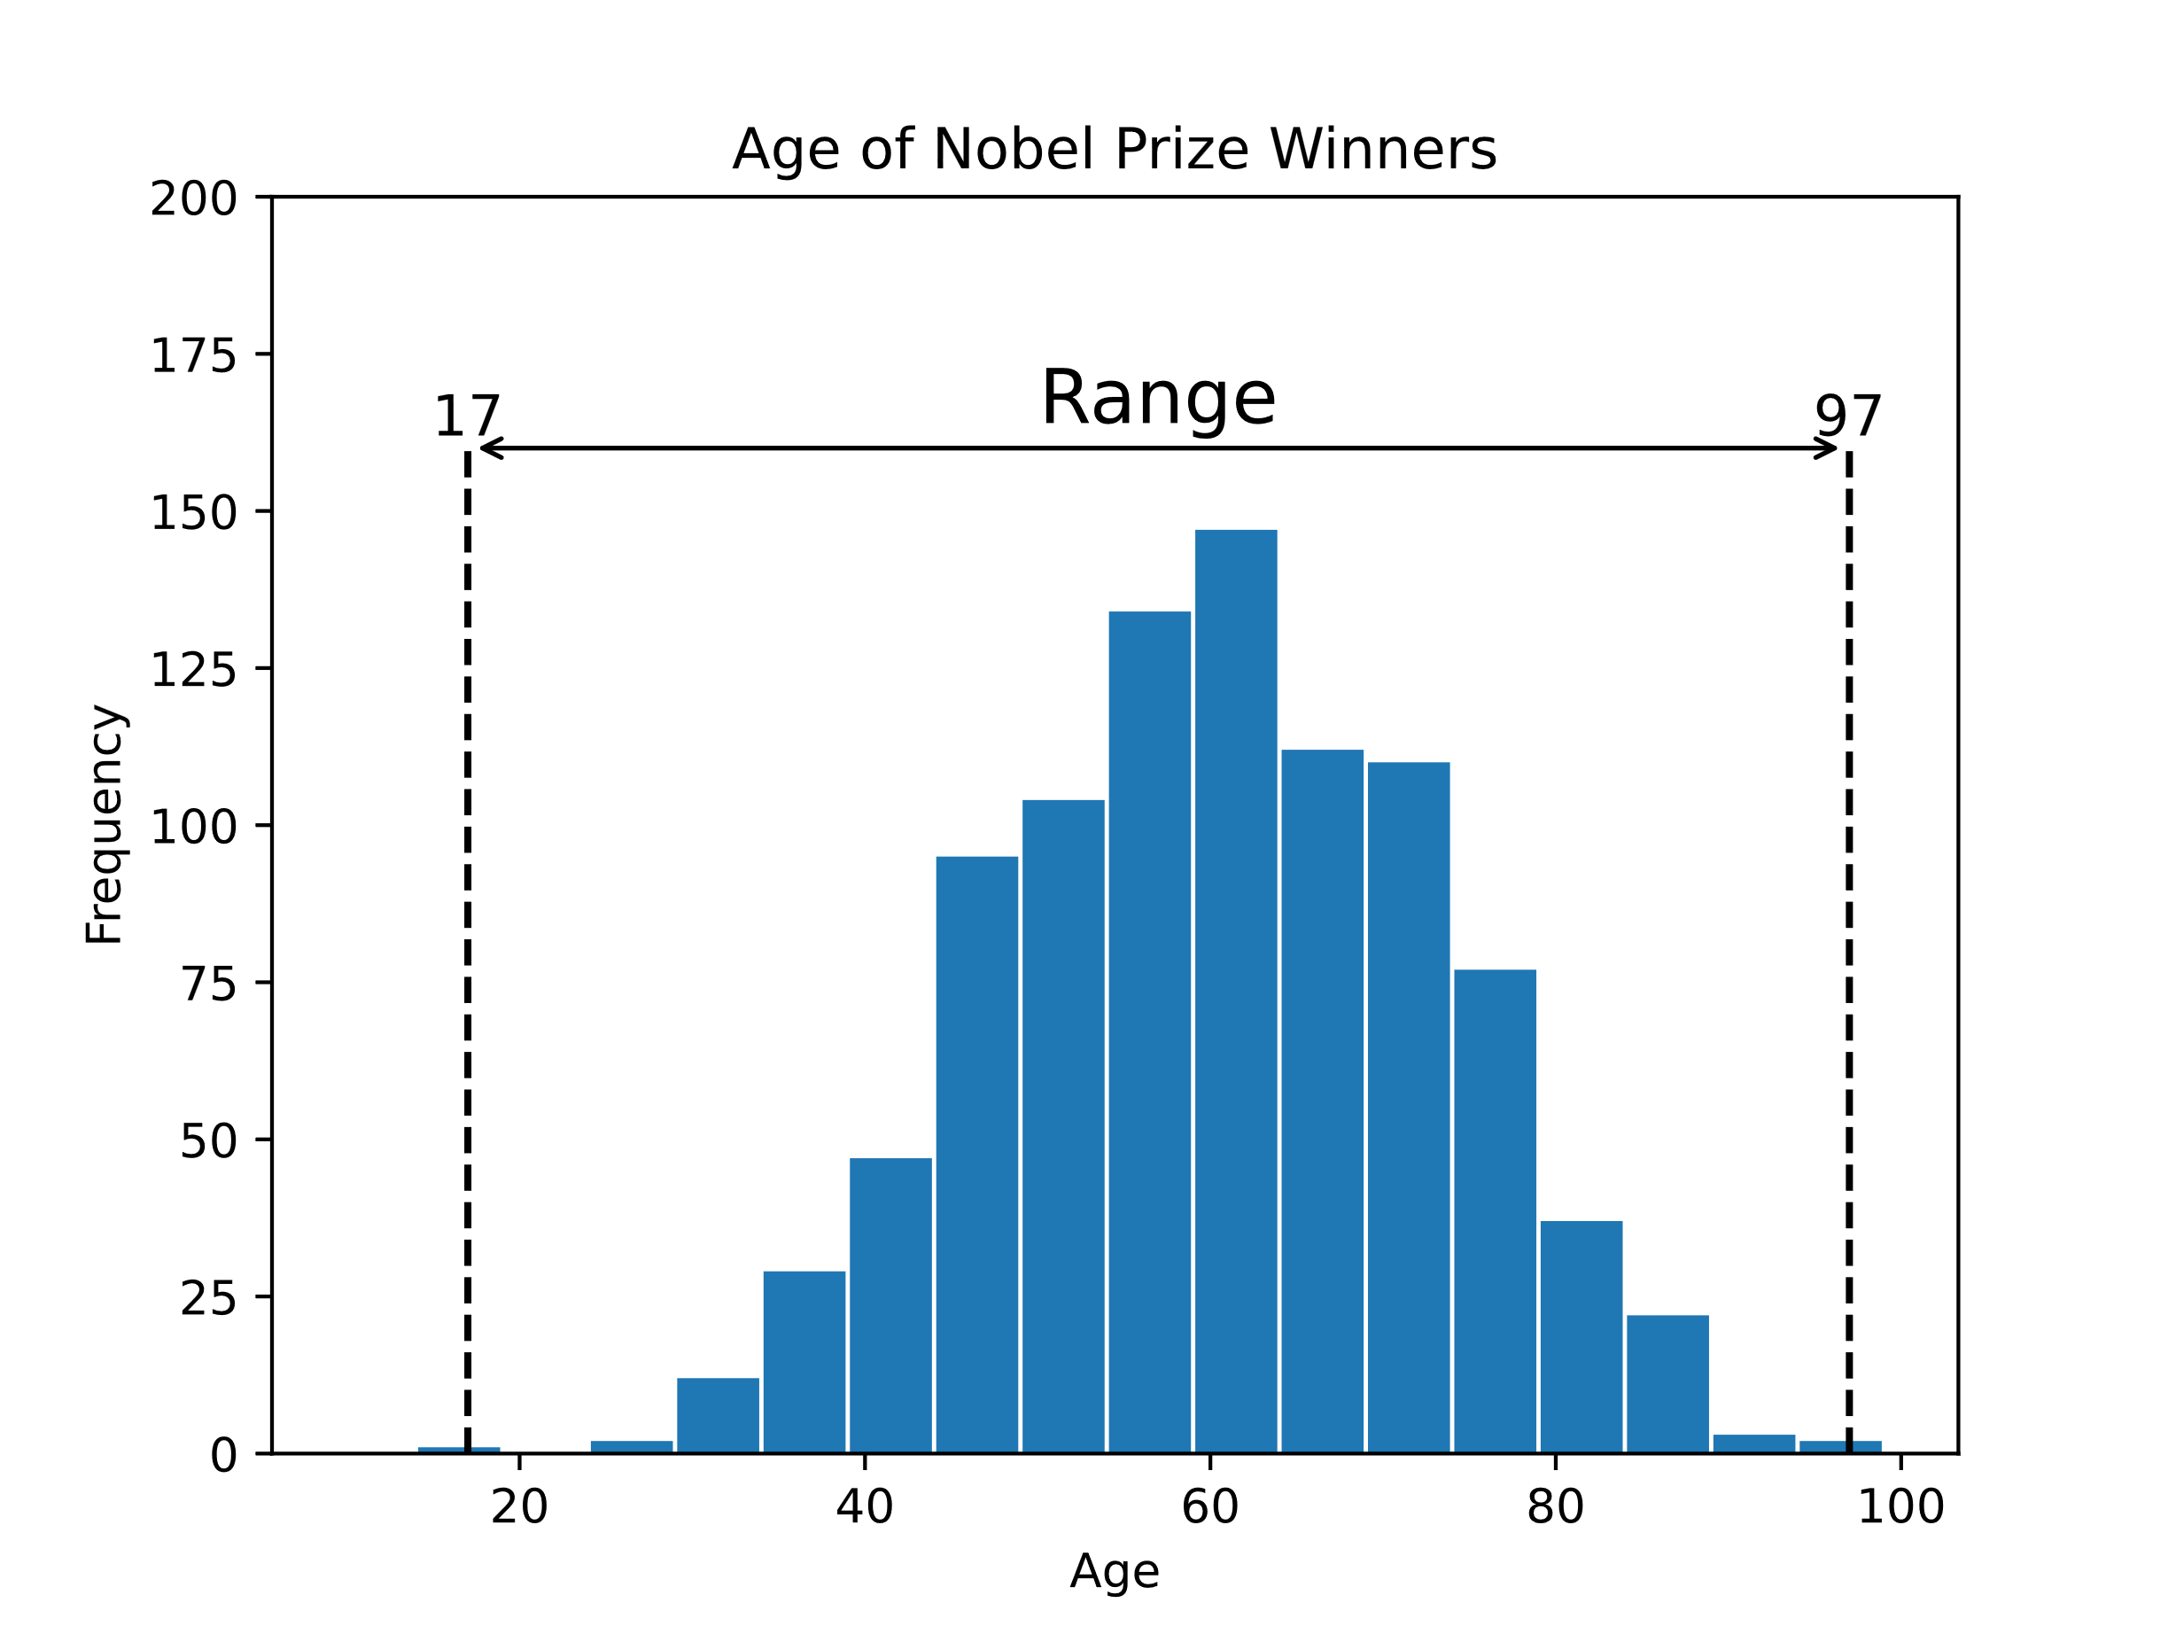
Range
The range is the difference between the smallest and the largest value of the data.
Range is the simplest measure of variation.
Here is a histogram of the age of all 934 Nobel Prize winners up to the year 2020, showing the range:
The youngest winner was 17 years and the oldest was 97 years. The range of ages for Nobel Prize winners is then 80 years

Slide 12
Range

Slide 13

Quartiles and Percentiles
Quartiles and percentiles are ways of separating equal numbers of values in the data into parts.
Quartiles are values that separate the data into four equal parts.
Percentiles are values that separate the data into 100 equal parts.
Here is a histogram of the age of all 934 Nobel Prize winners up to the year 2020, showing the quartiles:
The quartiles (Q₀,Q₁,Q₂,Q₃,Q₄) are the values that separate each quarter.
Between Q₀ and Q₁ are the 25% lowest values in the data. Between Q₁ and Q₂ are the next 25%. And so on.
Q₀ is the smallest value in the data.
Q₂ is the middle value (median).
Q₄ is the largest value in the data.

Slide 14
Quartiles and Percentiles

Slide 15

Interquartile Range
Interquartile range is the difference between the first and third quartiles (Q₁ and Q₃).
The 'middle half' of the data is between the first and third quartile.
Here is a histogram of the age of all 934 Nobel Prize winners up to the year 2020, showing the interquartile range (IQR):
Here, the middle half of is between 51 and 69 years. The interquartile range for Nobel Prize winners is then 18 years.

Slide 16
Interquartile Range

Slide 17

Standard Deviation
Standard deviation is the most used measure of variation.
Standard deviation (σ) measures how far a 'typical' observation is from the average of the data (μ).
Standard deviation is important for many statistical methods.
Here is a histogram of the age of all 934 Nobel Prize winners up to the year 2020, showing standard deviations:
Note: Values within one standard deviation (σ) are considered to be typical.
Values outside three standard deviations are considered to be outliers.

Slide 18
Skewness and Kurtosis

Slide 19
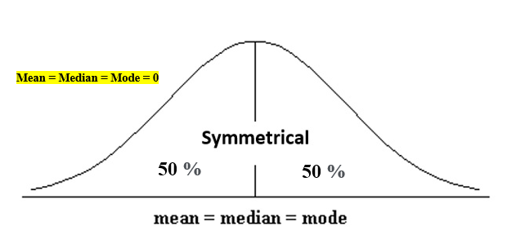
Skewness
If the values of a specific independent variable (feature) are skewed, depending on the model, skewness may violate model assumptions or may reduce the interpretation of feature importance.
In statistics, skewness is a degree of asymmetry observed in a probability distribution that deviates from the symmetrical normal distribution (bell curve) in a given set of data.
The normal distribution helps to know a skewness. When we talk about normal distribution, data symmetrically distributed. The symmetrical distribution has zero skewness as all measures of a central tendency lies in the middle.
When data is symmetrically distributed, the left-hand side, and right-hand side, contain the same number of observations. (If the dataset has 90 values, then the left-hand side has 45 observations, and the right-hand side has 45 observations.). But, what if not symmetrical distributed? That data is called asymmetrical data, and that time skewness comes into the picture.

Slide 20
Skewness

Slide 21
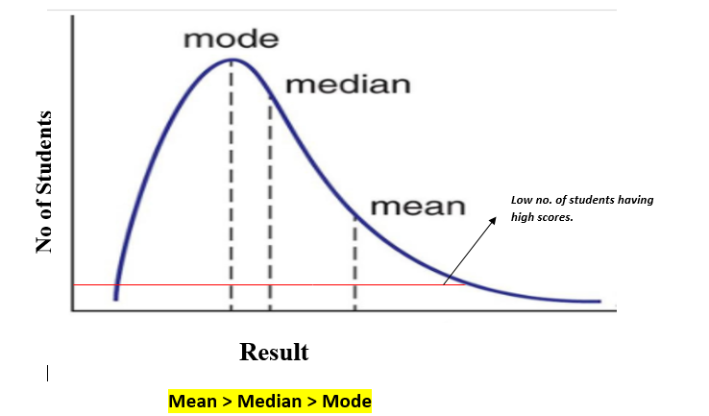
Types of skewness
1. Positive skewed or right-skewed
In statistics, a positively skewed distribution is a sort of distribution where, unlike symmetrically distributed data where all measures of the central tendency (mean, median, and mode) equal each other, with positively skewed data, the measures are dispersing, which means Positively Skewed Distribution is a type of distribution where the mean, median, and mode of the distribution are positive rather than negative or zero.

Slide 22
Types of skewness
In positively skewed, the mean of the data is greater than the median (a large number of data-pushed on the right-hand side). In other words, the results are bent towards the lower side. The mean will be more than the median as the median is the middle value and mode is always the highest value
The extreme positive skewness is not desirable for distribution, as a high level of skewness can cause misleading results. The data transformation tools are helping to make the skewed data closer to a normal distribution. For positively skewed distributions, the famous transformation is the log transformation. The log transformation proposes the calculations of the natural logarithm for each value in the dataset.

Slide 23
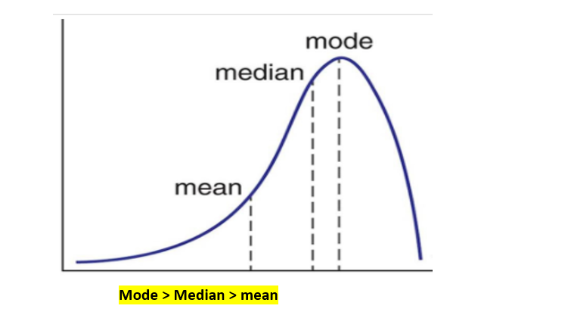
Types of skewness
2. Negative skewed or left-skewed
A negatively skewed distribution is the straight reverse of a positively skewed distribution. In statistics, negatively skewed distribution refers to the distribution model where more values are plots on the right side of the graph, and the tail of the distribution is spreading on the left side.
In negatively skewed, the mean of the data is less than the median (a large number of data-pushed on the left-hand side). Negatively Skewed Distribution is a type of distribution where the mean, median, and mode of the distribution are negative rather than positive or zero.

